Slide 2
DC Motor Control
By: Samuel Mandody

Slide 3
How does a DC motor function?

Slide 4
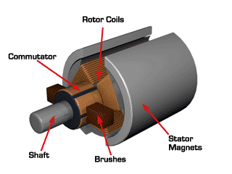
How does a DC motor function?

Slide 5
How does a DC motor function?
Cons of driving motor with DC?

Slide 6
Cons
No control over direction
No control over speed
No control over power consumption

Slide 7
H-Bridge

Slide 8
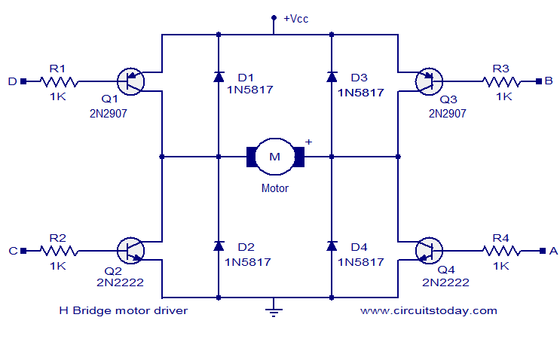
H-Bridge

Slide 9
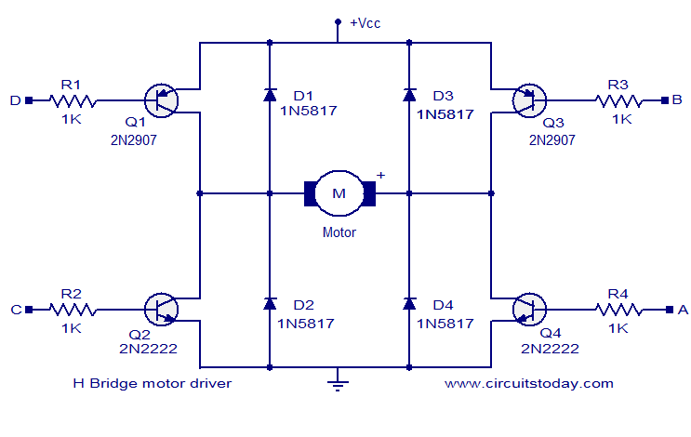
Why NMOS over PMOS?

Slide 10
NMOS vs. PMOS
Electrons as the primary carrier
Smaller and easier to manufacture so cheaper
Sadly, more noise prone

Slide 11


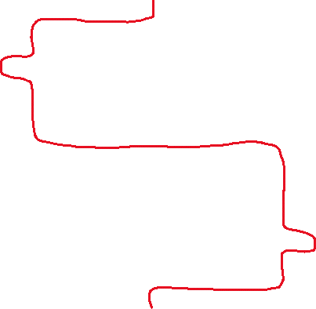

Slide 12


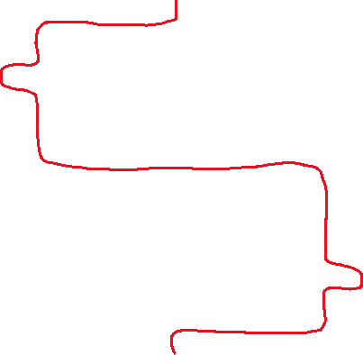
Can you use a microcontroller to drive an H-Bridge directly?

Slide 13
Yes, but you really should not.
Low resistance NMOSFETs = Higher gate voltage requirement.
Higher resistance = power loss through heat dissipation.
Shoot through.

Slide 14
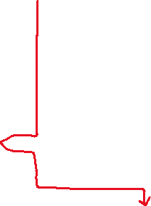


Shoot through

Slide 15
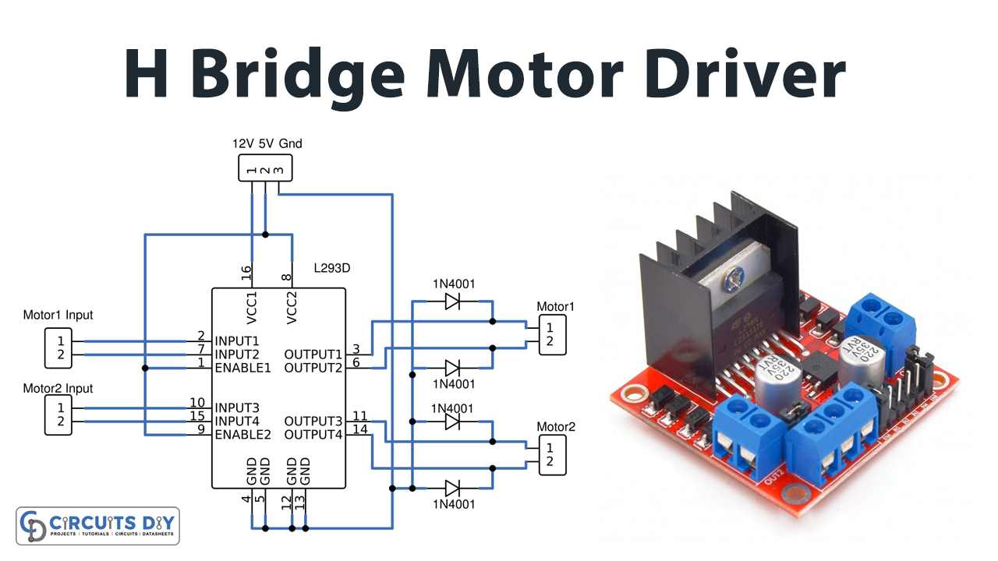
Motor Driver

Slide 16
PWM

Slide 17
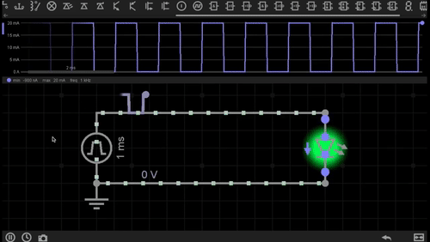
PWM

Slide 18
PWM
What if the terrain changes?/How to regulate acceleration?

Slide 19
Motor Controller W/Driver

Slide 20
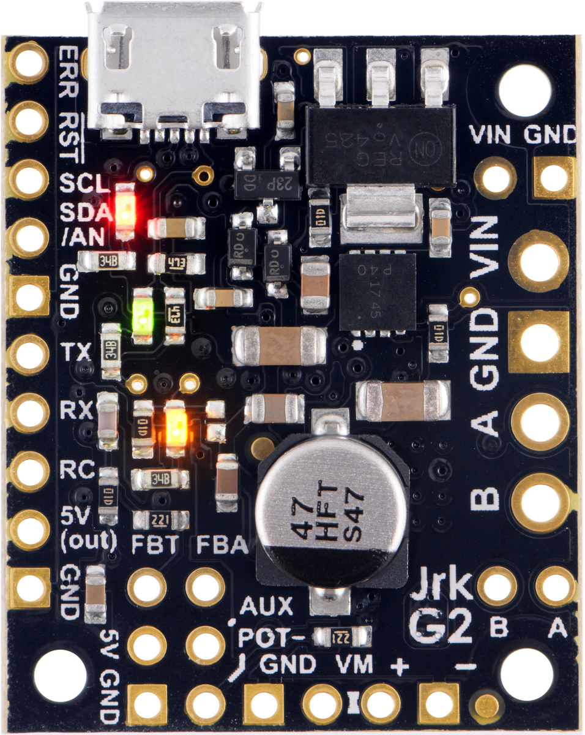
Motor Controller W/Driver

Slide 21
Motor Controller W/Driver
How do they work and control velocity?

Slide 22
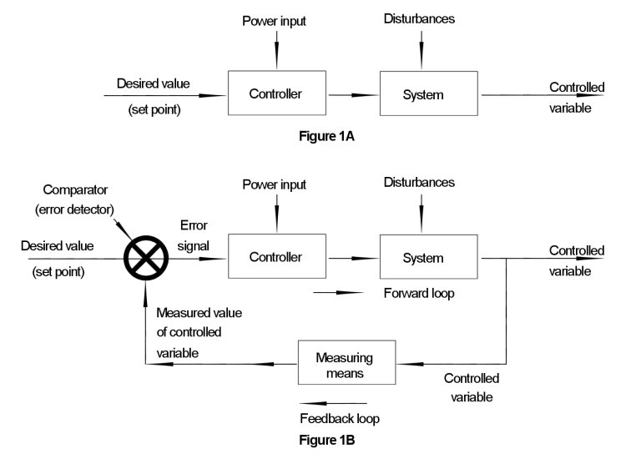
Control Types

Slide 23
Pros of motor controller
Variety of control interfaces
Built in libraries to simplify control of motors
Built in CRC error checking (data checking at both ends)
Automatic noise reduction filter for PWM
Allow for closed or open loop control

Slide 24
References for images (in order)
https://www.motioncontroltips.com/faq-how-can-brush-wear-in-dc-motors-be-minimized/
https://www.circuitstoday.com/h-bridge-motor-driver-circuit
https://www.circuits-diy.com/h-bridge-motor-driver-circuit-l293d/
https://gfycat.com/blushingoddcanary
https://www.pololu.com/product/3142
https://www.pesquality.com/blog/open-loop-and-closed-loop-systems

